Slide 1
Presentation: Qld Mining towns
William Lovell – Oct 2019

Slide 2
Problem statement:
Mining towns are often very small and very remote – making it difficult for mining companies to attract potential candidates to the towns and to retain them as their expectations are often very different to reality.
Using foursquare data we will build up a picture of different types of towns so better realistic job previews can be delivered.

Slide 3
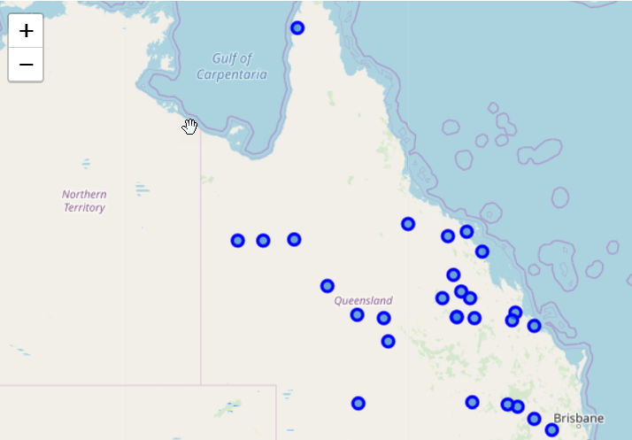
Map of QLD
The data consisted of 27 small mining towns in QLD Australia.
There was a wide mixture of towns in terms Population (900 people – 70,000) and location – coastal, country, very remote

Slide 4
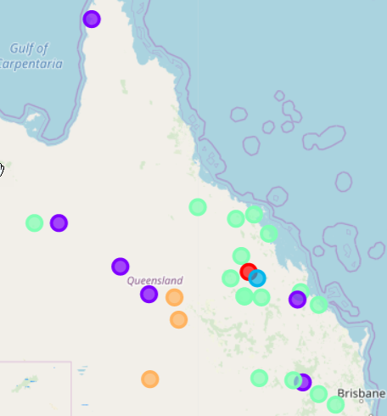
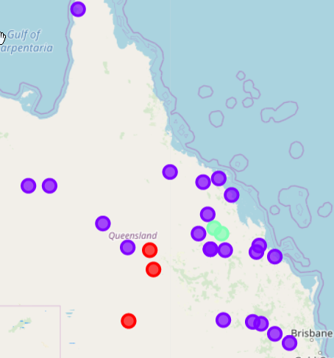
Clusters: 5 vs 3
Clusters of 3,4, and 5 were created.
Clusters 3 and 5 were rejected due to over lack of granularity vs over clustering. E.g. the three cluster model resulted in one very big cluster and the five cluster model created additional clusters that couldn’t be explained.

Slide 5
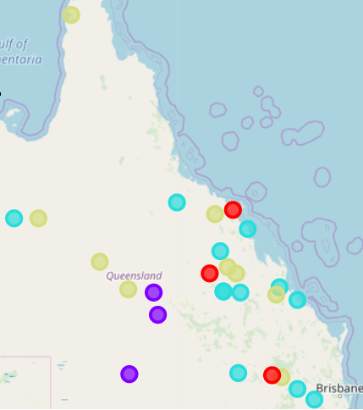
Four Cluster Model
Clusters analysis: The five cluster analysis resulted in a cluster of one town, and the three cluster analysis resulted in one cluster of 21 – whereas the four cluster analysis resulted in a nice mix of towns.
Cluster one: Quilpie, Barcaldine, Blackall . These are simple, small towns highlighted by Airports which indicates they are most likely Fly in Fly out towns, their other venues are simple highlighted by campgrounds, convenience stores, and fast food stores. Populations: 654 – 1316.
Cluster two: Mt Isa, Mackay, Gladstone, Dalby and Toowoomba. The towns in cluster two are larger, and more established with long histories they are highlighted by venues more expected to be found in large towns like Shopping Malls, Supermarkets, and different categories of food options from Fast Food to coffee shops to Italian food. Another feature also appears to the Movie theatres/Multiplexes. This is supported by the population data with towns in this cluster having between 18000 – 96,000 population.
Cluster 3: Weipa, Cloncurry, Collinsville, Chinchilla. Population: 1500-3000. These historic towns appear to have common venues related to tourism including Motels, RV Parks and Campgrounds, Scenic Lookouts, and Concert halls.
Cluster 4: Clermont, Proserpine, Miles Populations: 1169- 3562. The towns in cluster four are geographically aligned and have a mixture of key fixtures including Café’s, Hotels, Grocery Stores.

Slide 6
Conclusion
This project aimed to create a picture of ‘small mining towns’ in QLD to help employers provide their prospective employees with a realistic understanding of the living conditions within the town, including building up a picture of weather a town was ‘family’ friendly or more suited to a single or fly in fly out lifestyle. This was achieved in the analysis however could have included other features to build a more complex picture.

